Slide 1
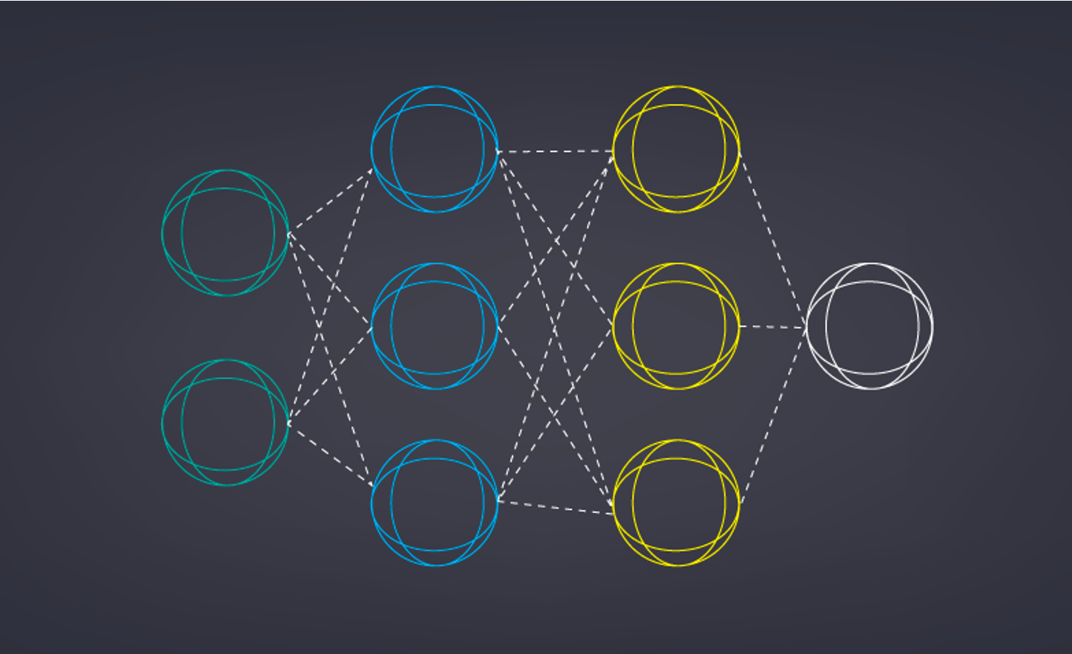
Image Colorization with Deep Convolutional Neural Networks
Mit20
Tahseen zaman
Student No: 132032
Supervised by:
Dr. Ahmedul Kabir
Assistant Professor

Slide 2
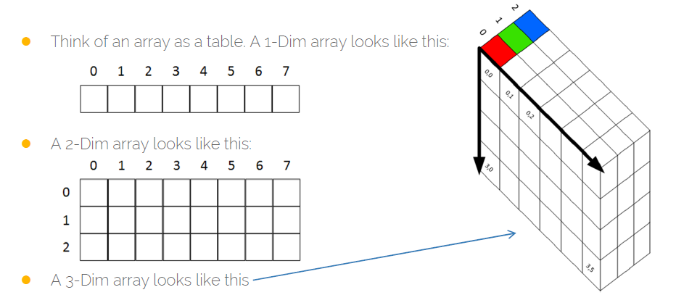

Objective:
Taking a Black and white image as input produce a colorized image that represents the semantic colors and tones of the input using the Convolutional Neural Network model.
Image and Colorization:
Images are represented with different color spaces in Digital formats like RGB,HSV,CMYK. Color image is stored as 3D Array. We use LAB space in our implementation. LAB expresses color as three values: L for black and white, A for green (−) to red (+), and B for blue (−) to yellow(+).

Slide 3
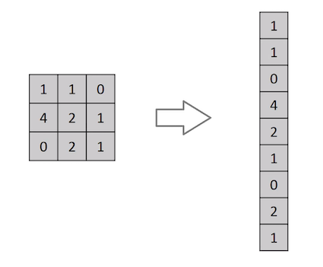
Why cnn, not Forward feed is preferred?
Gives better accuracy compared to forward feed networks
No need to preprocess the data for features
Model has better understanding of spatial features of Images
System learns Features by itself from examples then Features of one layer is passed to another layer

Slide 4
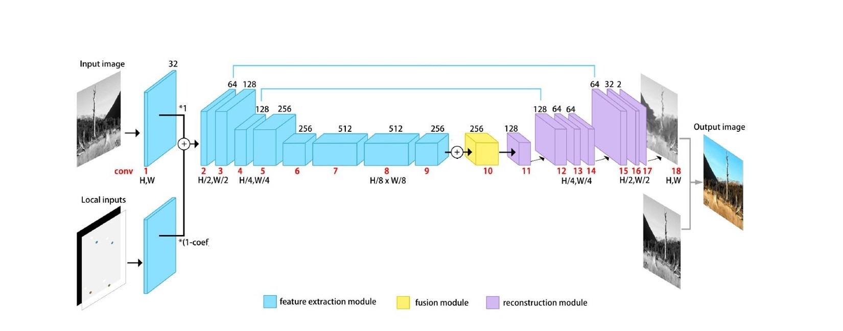
Methodology:
Our Model is a CNN based Encoder and DCN based Decoder
L channel of image is passed as input
The input image the dimension are reduced by down sampling: Encoding
The dimension are brought back to original by up sampling: Decoding
For L values of A and B values are predicted
We use the same input image(A, B channel) to calculate loss
Model learn weights and bias for Training set, validated against images not shown in Training

Slide 5
Implementation:
Gathering data(colored-B&W images)
Data pre-processing
Converting Images to LAB color space, size: 224x224x3 pixel
Separating L , A and B channels
We Normalize the Data dividing by 127 for better CNN performance
We made a 3-D matrix with L value and with one, all one matrix
For the Encoder part we used VGG-16’s first 18 layer of CNN
Dataset name | Size | Categorical
Landscape and Nature | 2,688 | Landscape and Nature
Human Gesture recognition | 4,000 | Human
MIT CVCL Urban and Natural Scene | 4,319 | Landscape and Nature
Wallpapers from web | 15,000 | Landscape and City

Slide 6
Implementation:
Data collection
24,000 Images
Preprocessing
LAB conversation
Separating Channels
Input of Model
224x224x2 in size
Normalization
L channel
Encoder
Convolution
Max Pooling
Decoder
Up Sampling
De Convolution
Post Processing
De-Normalization
Resize
Conversion
Testing The Model
Loss
Over fitting
We used “keras” API to make Decoder Model with Convolutional Neural Network
The output from Encoder part is passed in Decoder, the matrix is then up sampled with De-convolution and up sampling
The values of A and B is multiplied by 128 as De-Normalization process
Three separate channels combined to LAB image.
Conversation to RGB

Slide 7
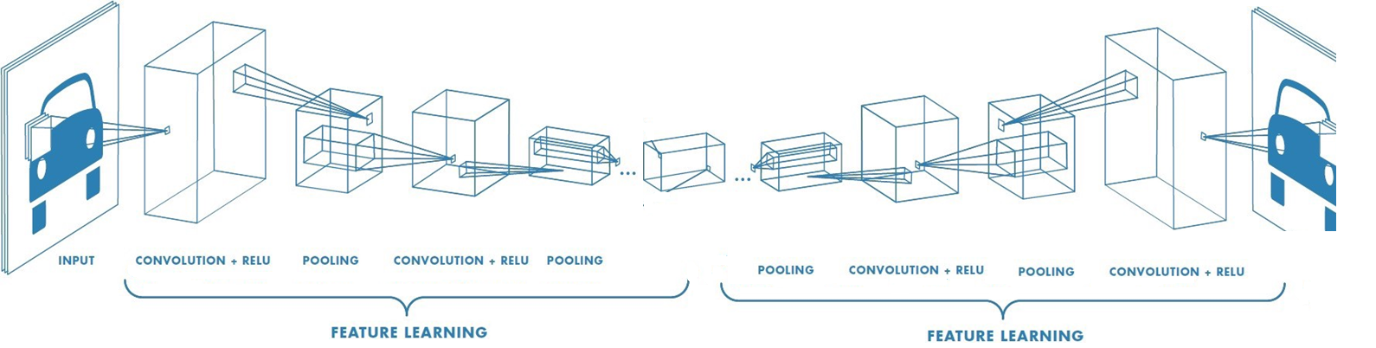
Properties OF our Encoder & Decoder:
One Convolution layer and one Pooling is referred as depth one for convolution
Our model depth is of 5 for Encoding 5 for Decoding
3x3 kernel with 2x2 max pooling
Relu activation function
Padding of one
VGG-16 a trained model was used as Encoder
Epochs of 3000 with batch size 128, of 24,000 images
ENCODER AND DECODER

Slide 8
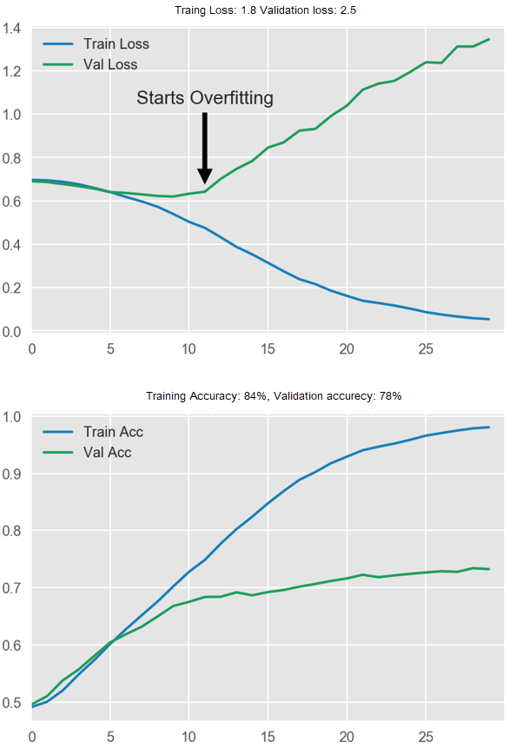
Training &Testing the model:
We used Keras’s Adam optimizer, and MSE for calculating loss
At first our model was over fitting, (Training accuracy of 75%, validation accuracy of 52%)
Using Lasso regularization and Ridge regularization we were able to counter over fitting Problem also increased accuracy (Training accuracy of 84% and validation accuracy of 78%)

Slide 9
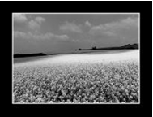
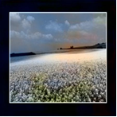
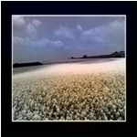
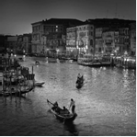
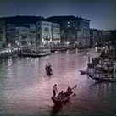
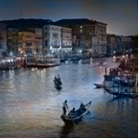
Evaluation
INPUT | Without L1 and L2 | With L1 and L2

Slide 10
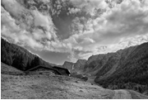
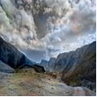
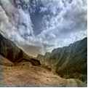
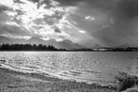
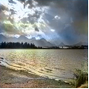
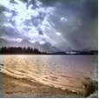
Evaluation
INPUT | Without L1 and L2 | With L1 and L2

Slide 11
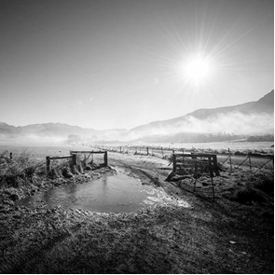
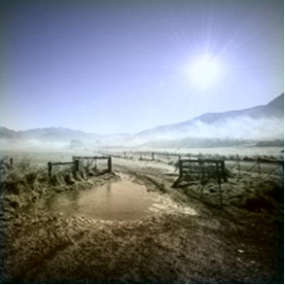
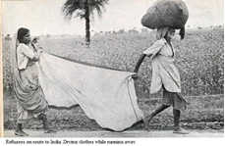
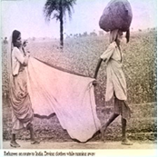
evaluation
INPUT | OUTPUT

Slide 12
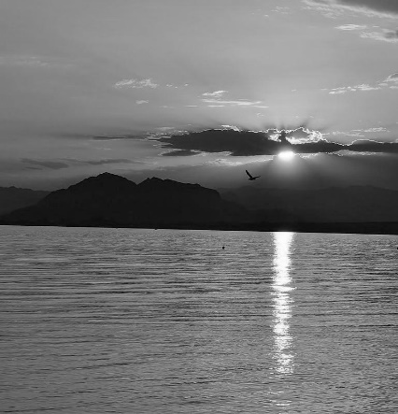
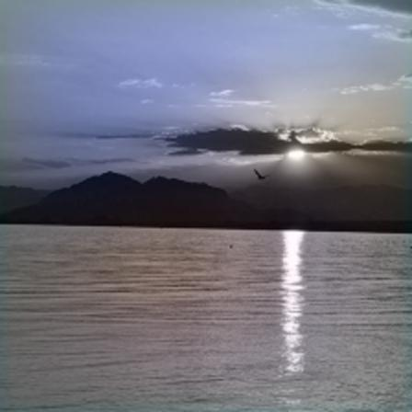
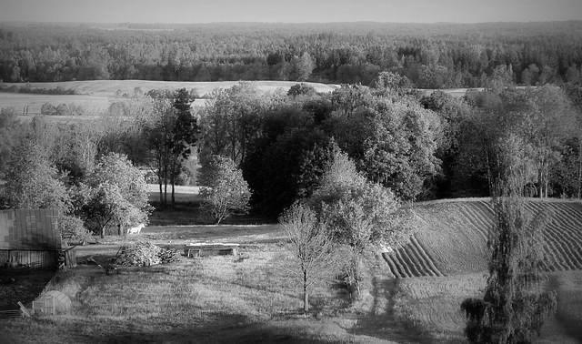
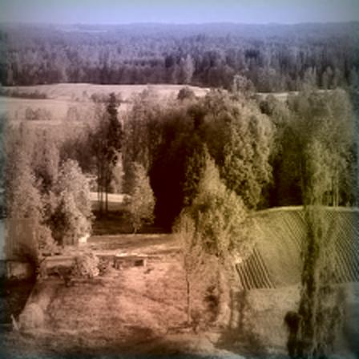
evaluation
INPUT | OUTPUT

Slide 13
Evaluation
MSE loss or accuracy don’t correctly represent the aesthetic satisfaction
This model performs remarkably well with foliage, skies and grass.
As it tends to generalize, object with multi color pallets came out unsaturated
This model struggles with human skin, most picture with human become Sepia
Though aesthetically outputs are pleasing, many differs from original tonality

Slide 14
Conclusion:
Though our model performs well with simple landscape, the colors are subdued and under saturated. More advanced model as such fusion of two CNN network at Encoder side might yield better results.
Many post processing schemes such as total variation minimization and conditional random fields can make output more pleasing to look at.

Slide 15
References used:
[1] | P. A. R. G. a. J. M. B. Hariharan, "Hyper columns for object segmentation and fine-grained localization".
[2] | X. G. a. Y. Bengio, Understanding the difficulty of training deep feedforward neural networks. In International conference on artificial intelligence and statistics.
[3] | X. Z. S. R. a. J. S. K. He, "Deep residual learning for image recognition".
[4] | [Online]. Available: https://towardsdatascience.com/applied-deep-learning-part-4-convolutional-neural-networks-584bc134c1e2.
[5] | [Online]. Available: https://towardsdatascience.com/applied-deep-learning-part-3-autoencoders-1c083af4d798.
[6] | P. I. A. A. E. Richard Zhang, "Colorful Image Colorization".
[7] | J. H. a. Y. Zhou, "Image Colorization with Deep Convolutional Neural Networks," IEEE.
[8] | S. Saha, "A Comprehensive Guide to Convolutional Neural Networks".

